Slide 1
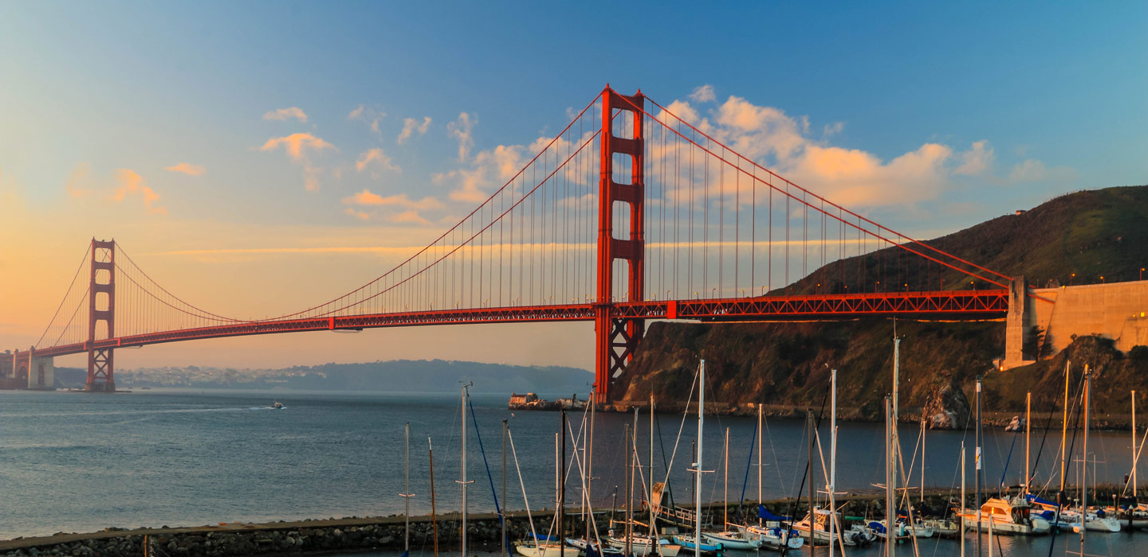
San Francisco Travel
IBM/Coursera Capstone Final

Slide 2
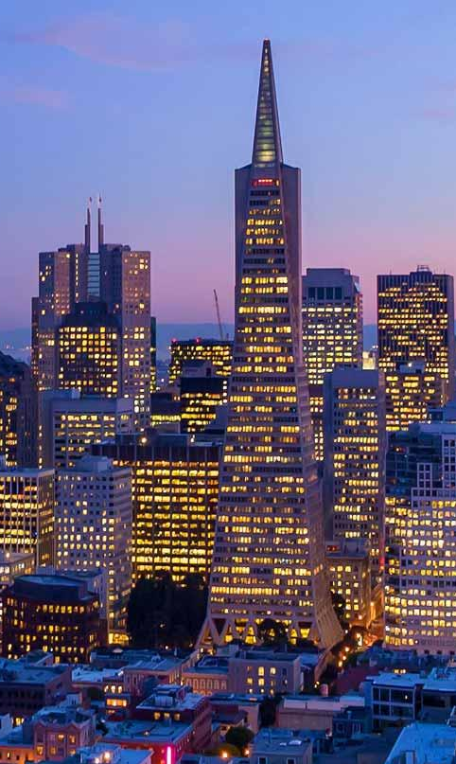
So many landmarks, so little time
San Francisco:
5th most populated city in the US
2nd most walkable city in the US
273 locations on the National Register of Historic Places
15.4 million tourists per year
How to see the most and best landmarks in the least amount of time?

Slide 3
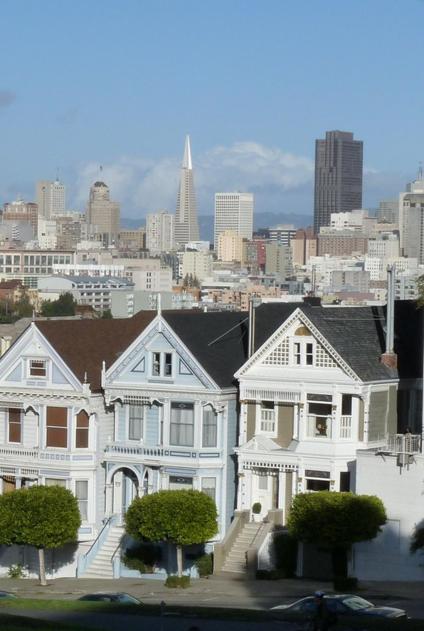
Data
Neighborhood outlines and names from codeforamerica on github
San Francisco landmarks from Google
Venue information from Foursquare
In total, 36 districts, 36 landmarks (coincidental) and 700 venues
Duplicate data removed

Slide 4
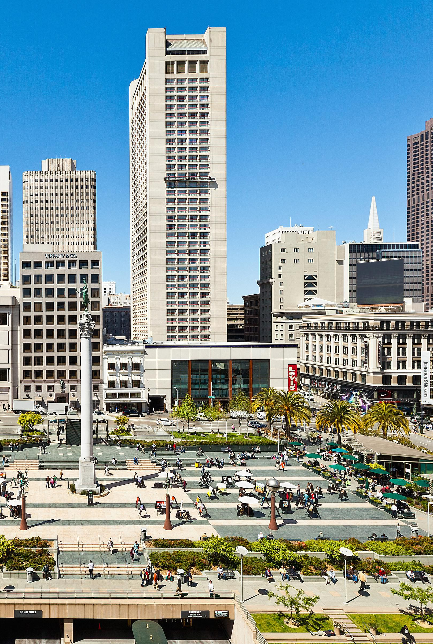
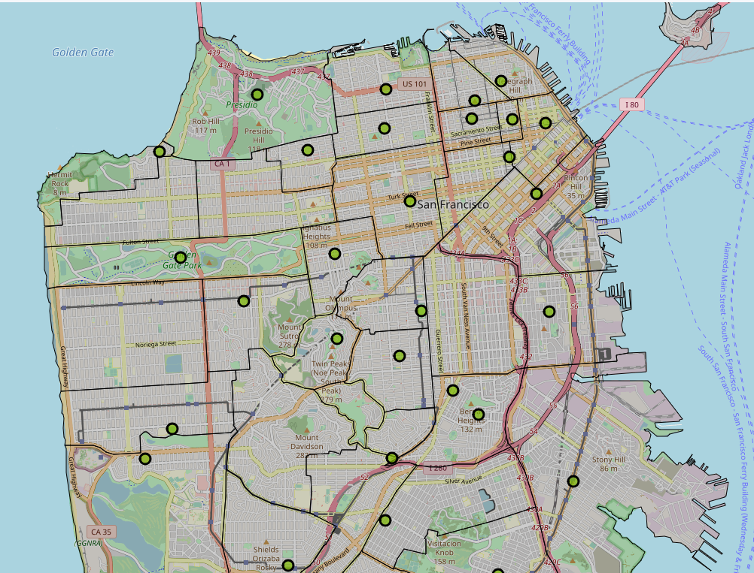
Neighborhoods

Slide 5
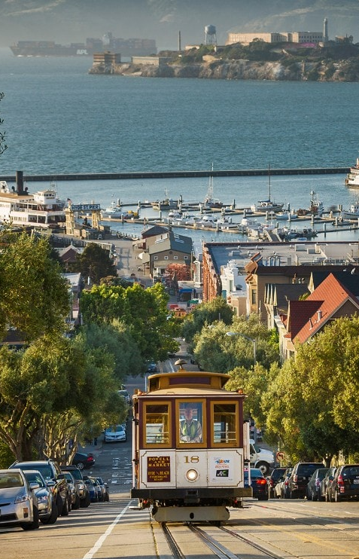

Landmark Overlayu
Overlaying the landmark data (red) over the neighborhood data, neighborhoods with the most landmarks are:
Chinatown
Nob Hill
Russian Hill
North Beach
Presidio
Golden Gate Park
Haight-Ashbury
These neighborhoods were isolated for further analysis.

Slide 6
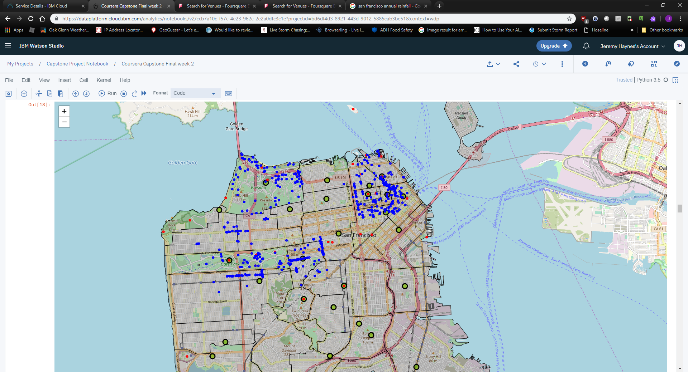
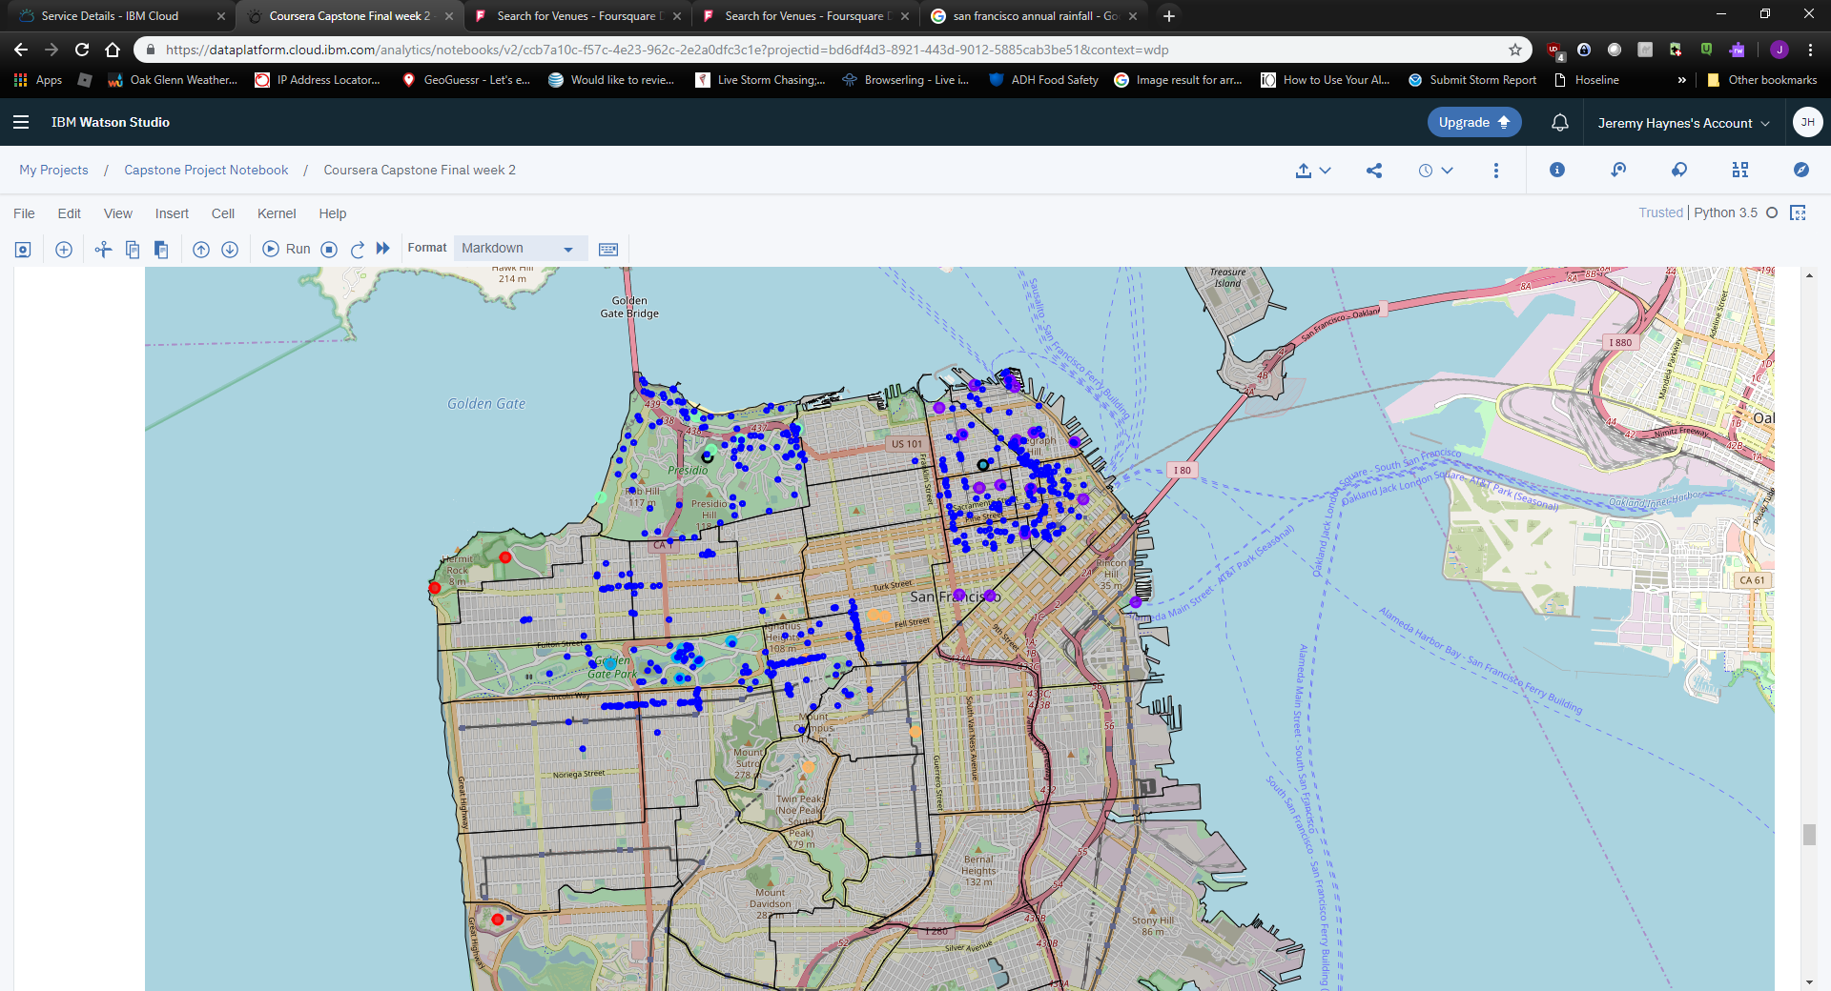
Venues
458 distinct venues
Mix of retail, dining, attractions
Not necessarily clustered near landmarks
Landmarks (red), neighborhoods (green), venues(blue)
Clustered Landmarks (various), venues(blue)

Slide 7
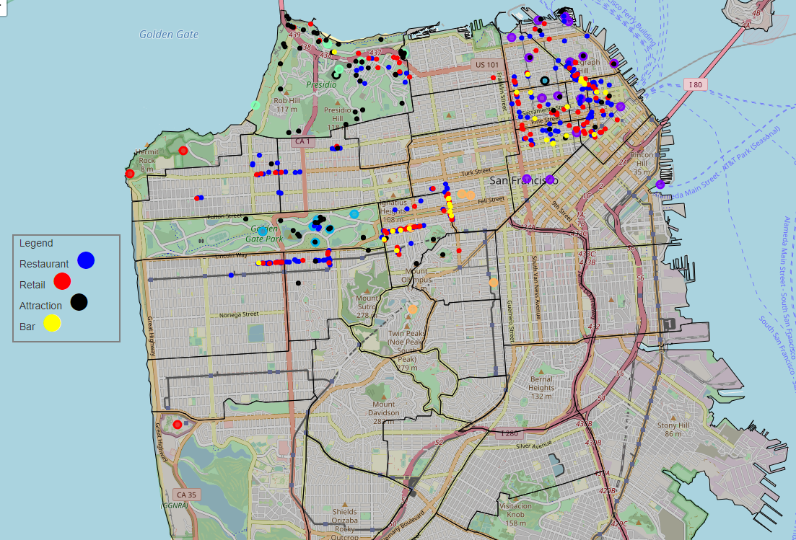
Venues
Broadened Categories
Placed distinct categories on clustered landmarks
Color coded

Slide 8
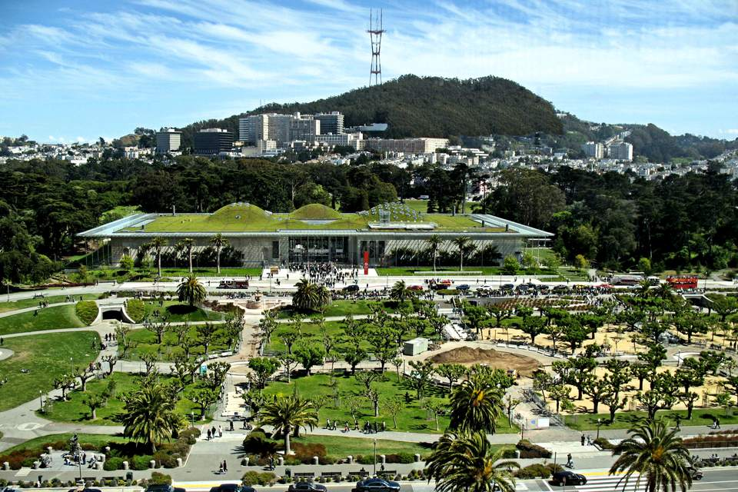
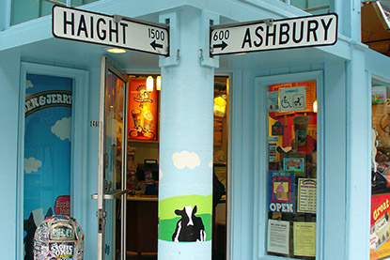
Results
Walking Tours:
Day 1 – Golden gate park
Over 10 attractions to visit
Limited food choices near landmarks
Nearest shopping 1 block from bordering street
Closest bars in Haight-Ashbury
Day 2 – Haigh-Ashbury
Few attractions of note
Attractions that do exist are mostly mountain summits
Large amount of bars/restaurants/retail but only along 2 streets which are several blocks apart

Slide 9
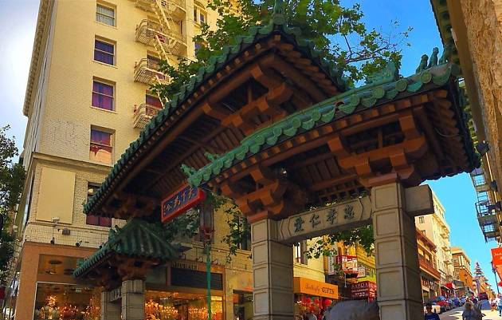
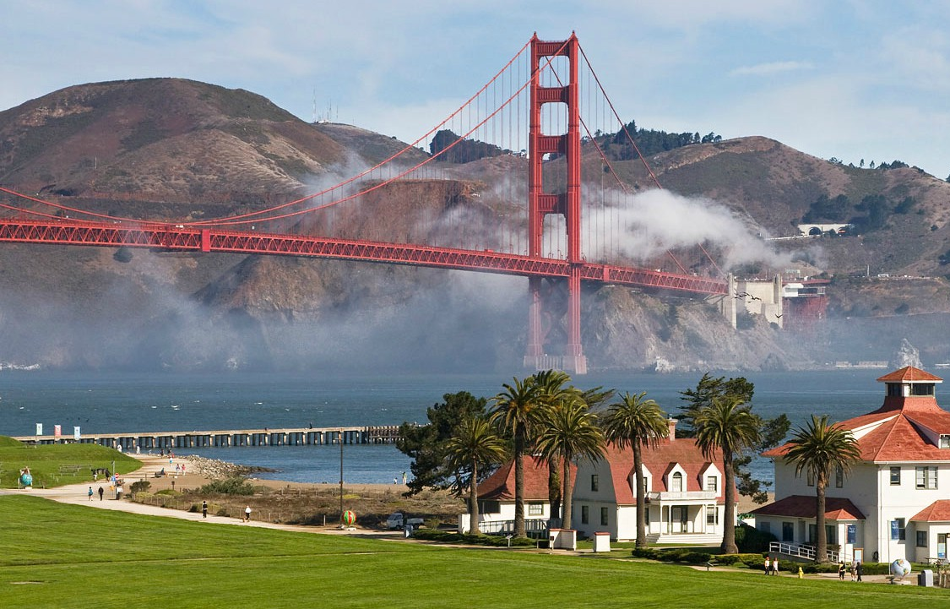
Results
Walking Tours:
Day 3 – Chinatown, Nob Hill, Russian Hill, North Beach
12 Attractions
Many restaurants/retail/bars, but mainly to the southeast
Most popular landmarks in North Beach
Day 4 – Presidio
36 Attractions
Very few restaurants
Little Retail, but several gyms
Nearest group of restaurants over a mile away from most popular attractions

Slide 10
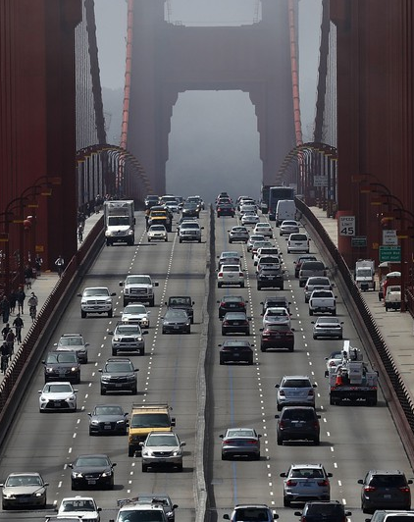
Conclusion and Future Directions
San Francisco is small and densely populated, as a result, the density of restaurants/retail/bars is low. Oakland to the Northeast provides a much wider variety of these types of locations
While San Francisco is a very walkable city, it’s also comprised of very steep hills. One must be prepared for that if they’re going to go on a walking tour
For those who do want to tackle the hills, a bike may be a better alternative than walking
List of venues has room for improvement, perhaps size by popularity or review score

